Slide 1
Overview slides
1 October 2024

Slide 2


Datasets
Hosted portals
108,760
23
Country Participants
63
Peer-review papers
using data
11,103
Organizational Participants
Average records
downloaded per month (2024)
43
192.6 billion
Species
occurrence records
Publishers
2,287
3,012,759,238
By the numbers | 1 October 2024
www.gbif.org

Slide 3
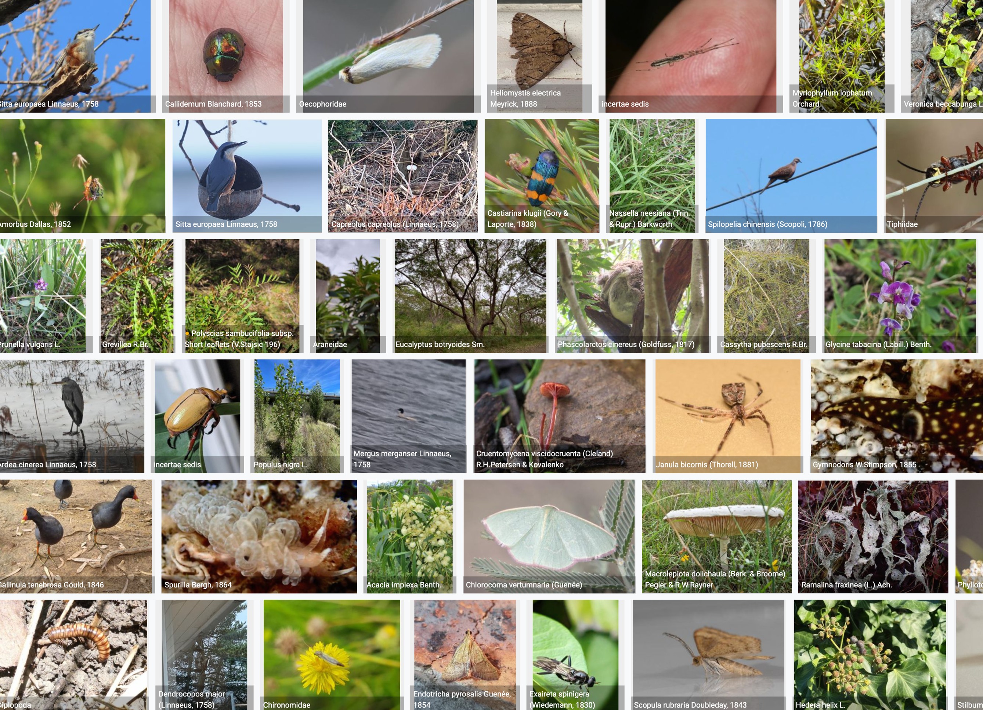
Species occurrence records with multimedia evidence
1 October 2024
205.6 million records with taxonomically identified images
133.3 million human observations
62.7 million specimens
7.1 million material samples
1.4 million fossil specimens
1,492,763 audio files
10, 780 videos
https://www.gbif.org/occurrence/gallery

Slide 4
GBIF Participant countries
1 October 2024
Voting Participants
Associate Participants

Slide 5
GBIF network of data publishing institutions
1 October 2024
144
countries/areas with institutions
sharing data through GBIF
Number of active publishers by country or area

Slide 6
GBIF.org traffic by country: 2024
1 October 2024
Rank | Country/Territory | Visitors | Visits | Effective visits* | % Effective visits | 2023 rank | Pages / visit
1 | United States | 779,034 | 874,459 | 323,550 | 11.10 % | 1 | 3.58
2 | Colombia | 307,357 | 392,210 | 179,957 | 6.17 % | 2 | 4.46
3 | Brazil | 308,641 | 353,795 | 155,670 | 5.33 % | 3 | 4.07
4 | France | 373,233 | 424,267 | 152,736 | 5.23 % | 6 | 3.32
5 | China | 629,072 | 876,904 | 149,074 | 5.11 % | 7 | 3.21
6 | Spain | 257,716 | 314,458 | 147,795 | 5.07 % | 8 | 5.29
7 | Mexico | 298,019 | 346,364 | 145,473 | 4.99 % | 4 | 4.13
8 | Indonesia | 199,094 | 242,581 | 135,845 | 4.66 % | 5 | 5.39
9 | Germany | 278,304 | 328,141 | 131,256 | 4.50 % | 9 | 4.55
10 | India | 248,339 | 274,140 | 101,432 | 3.48 % | 10 | 3.47
 | TOTAL | 6,569,963 | 7,905,285 | 2,917,958 | 100.00% |  | 4.23

Slide 7
Occurrences published by country: 2024
1 October 2024
Rank | Country/Territory | 2024 | 2023 total | 2023 rank
1 | United States | 151,836,151 | 151,004,708 | 1
2 | France | 43,756,280 | 13,208,845 | 5
3 | Canada | 22,001,851 | 22,744,659 | 3
4 | Netherlands | 21,169,219 | 14,293,849 | 4
5 | Australia | 11,973,542 | 12,714,959 | 6
6 | United Kingdom | 11,416,336 | 36,220,446 | 2
7 | India | 10,361,436 | 8,542,437 | 9
8 | Spain | 9,232,556 | 7,633,366 | 8
9 | Poland | 8,675,622 | 2,600,757 | 22
10 | Sweden | 7,527,698 | 9,339,841 | 7
OTHER COUNTRIES + AREAS | OTHER COUNTRIES + AREAS | 90,023,780 | 81,266,325
TOTAL |  | 387,974,471 | 355,993,458

Slide 8
Data download requests by country: 2024
1 October 2024
Rank | Country |  | 2024 | 2023 total | 2023 rank
1 | China | 39,651 |  | 39,253 | 1
2 | United States | 28,249 |  | 34,275 | 2
3 | Mexico | 20,284 |  | 26,051 | 3
4 | Colombia | 16,122 |  | 19,341 | 4
5 | Brazil | 14,305 |  | 18,370 | 5
6 | Spain | 9,275 |  | 13,492 | 6
7 | United Kingdom | 8,749 |  | 10,044 | 7
8 | Germany | 5,933 |  | 5,788 | 10
9 | Canada | 5,880 |  | 6,649 | 9
10 | France | 5,787 |  | 7,248 | 8
OTHER COUNTRIES + AREAS | ALL OTHERS | 82,368 |  | 87,262
TOTAL |  | 236,603 |  | 267,773
151
countries, islands & territories where users have ≥10 requested downloads

Slide 9
Peer-reviewed publications using GBIF-mediated data
1 October 2024
Notes:
The next 3 slides are showcasing PPT standard or Live charts.
To create a chart simply click on the Insert tap on the ribbon > Click on Chart > chose a chart of your choice (in this example I chose, Bar) > add in your data in the automatically opened Excel sheet and see your chart changing and adopting to the new information you have entered in the data sheet.

Slide 10
Data use in peer-reviewed journals: 2024
1 October 2024
Peer-reviewed uses by country
Peer-reviewed uses by region
End of Year |  |  | 2024 total | 2023 total | 2023 rank
1 | China |  | 390 | 381 | 2
2 | United States |  | 341 | 387 | 1
3 | Brazil |  | 159 | 191 | 3
4 | Mexico |  | 137 | 129 | 7
5 | Germany |  | 129 | 163 | 5
6 | United Kingdom |  | 127 | 182 | 4
7 | Spain |  | 124 | 130 | 6
8 | Australia |  | 84 | 94 | 9
9 | France |  | 79 | 108 | 8
10 | Italy |  | 78 | 79 | 10

Slide 11

Suggestions reviewed
Institutions
8,547
1,610
vv
Countries
Collections
112
8,125
Country editors
Digitized specimens
53
229,025,693
GRSciColl by the numbers | 1 Oct 2024
scientific-collections.gbif.org

Slide 12




Hosted portals
12
GBIF Participant and GBIF Regional
4
Institutional
23
Hosted portals in production
7
29
Networks/thematic networks
In development
Notes:
After a pilot programme, the first 5 portals went live in October 2021.
These included portals from:
GBIF.us Sponsored and co-developed by the Science Analytics and Synthesis Program (SAS) of the U.S. Geological Survey (USGS)
Legume Data Portal Sponsored by Canadensys and co-developed by the Legume Phylogeny Working Group
PBIF: Pacific Biodiversity Information Facility Sponsored and co-developed and by Secretariat of the Pacific Regional Environmental Programme (SPREP))
Rotterdam Natural History Museum Sponsored by NLBIF)
SiB Colombia
There are currently 21 hosted portals in production from GBIF participants, publishing institutions and networks. There are 29 more in development.

Slide 13
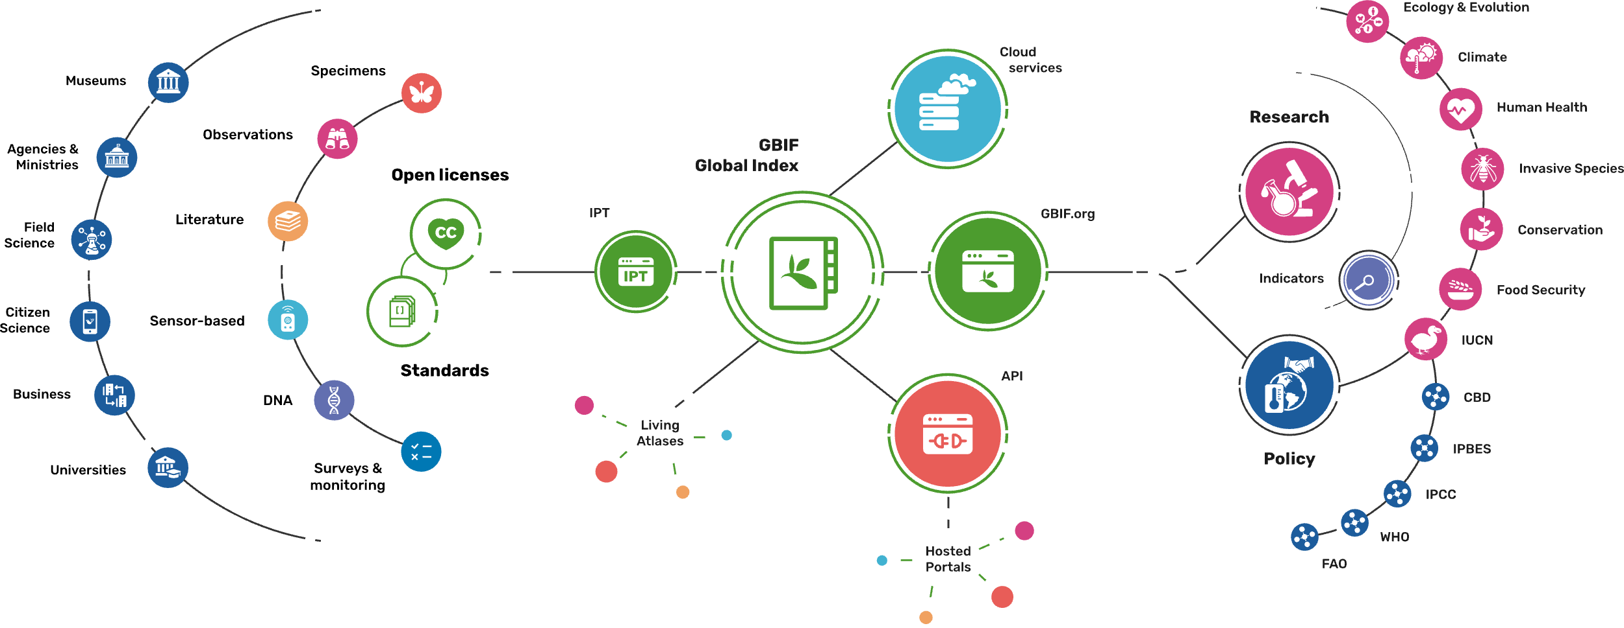
Providing biodiversity evidence for research and policy

Slide 14
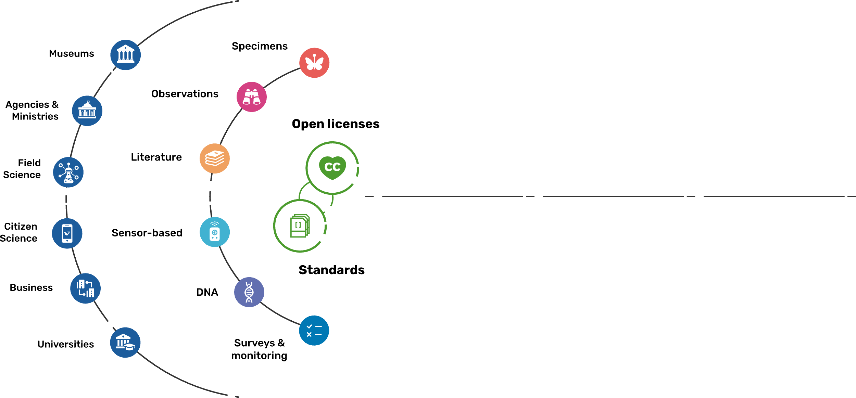
Sources of biodiversity evidence
Create
Combine sources of evidence

Slide 15
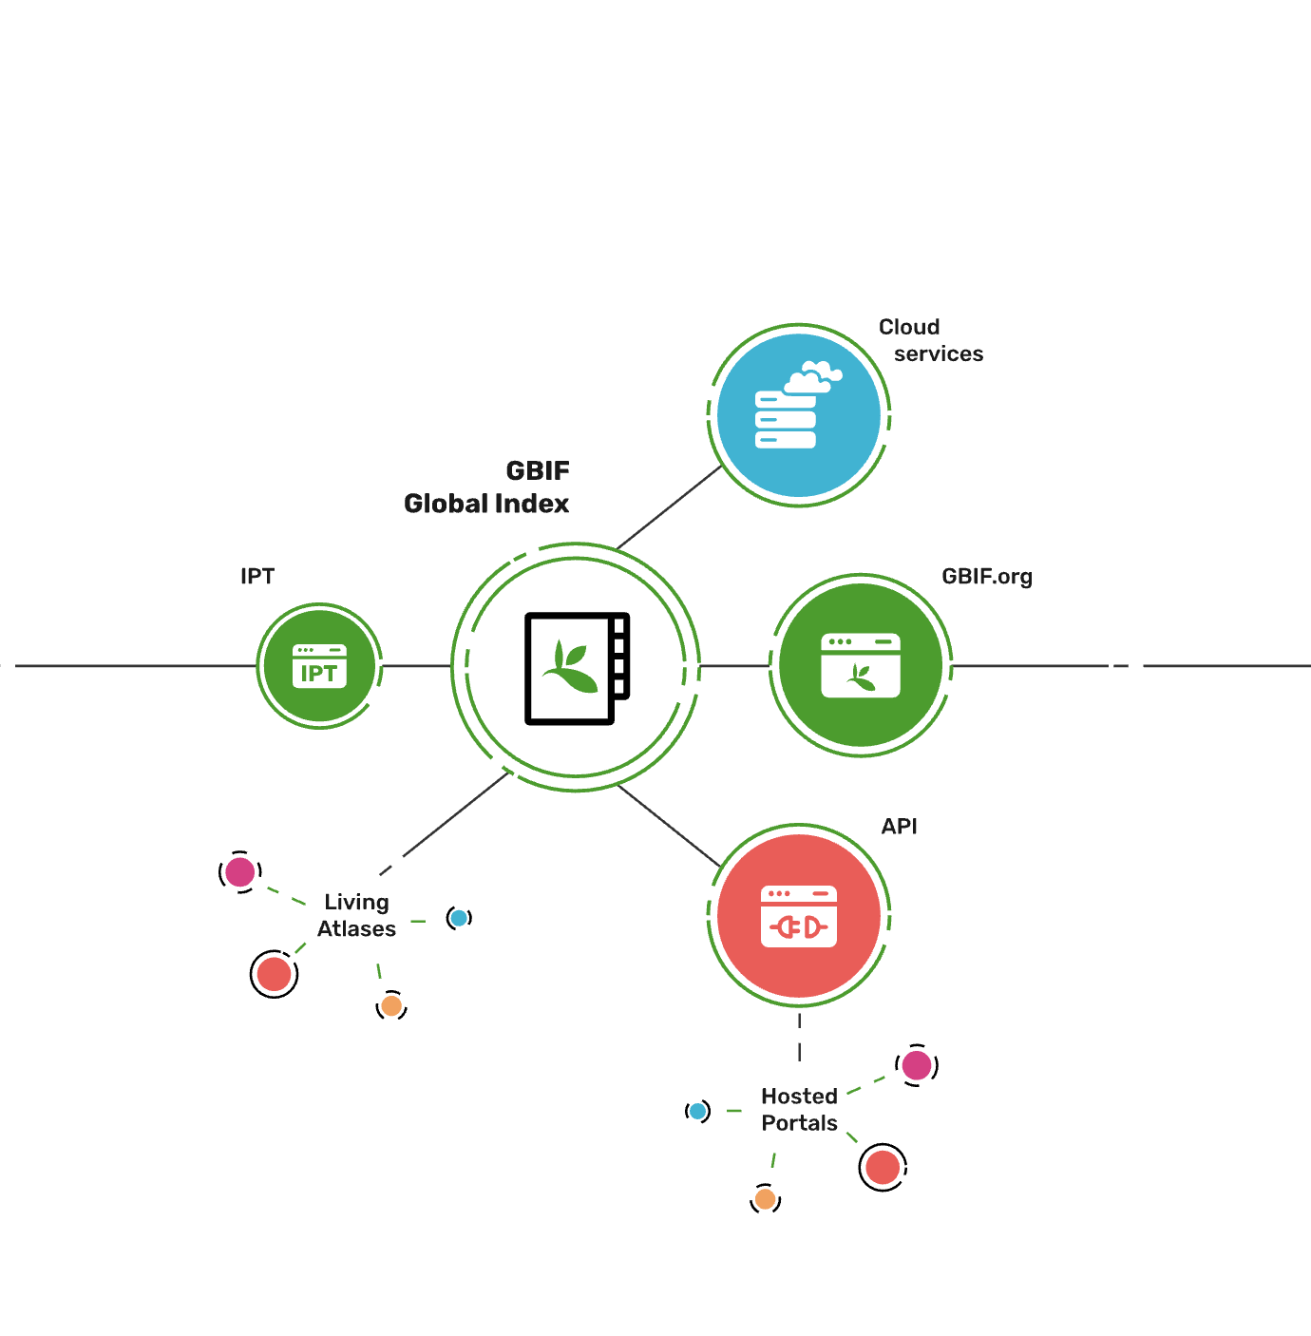
Access to biodiversity evidence
Share
FAIR and open access

Slide 16
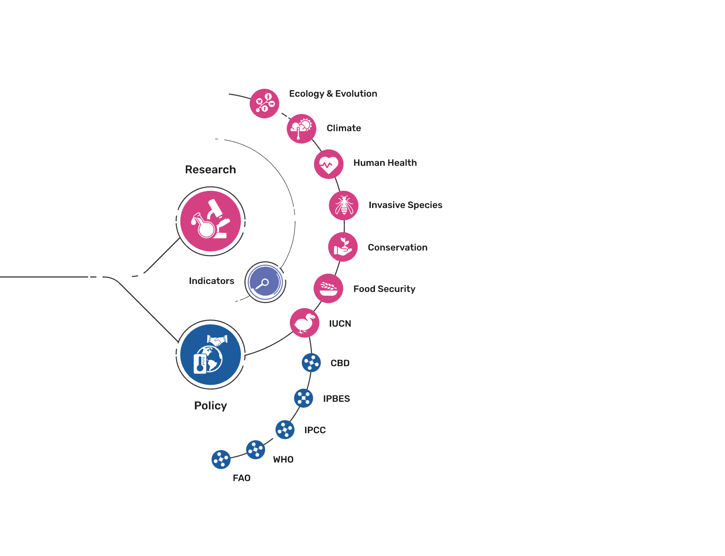
Uses of biodiversity evidence
Transform
Apply and use data

Slide 17


